Slide 1










The Wellness Journey
Software Engineering Project Presentation
Mood Tracking
Nutrition Log
Hydration
Progress
Empowering healthier lifestyles through technology

Slide 2
















Project Overview & Objectives
The Wellness Journey
A comprehensive wellness tracking application designed to help users monitor their daily health activities including mood, nutrition, hydration, and progress tracking.
Track Daily Metrics
Monitor Nutrition
Ensure Hydration
Monitor mood, nutrition, hydration, and other wellness metrics with ease.
Track food intake and calories with a comprehensive journal system.
Track water intake with visual indicators and quick increment buttons.
Visualize Progress
Personalized Profiles
Interactive charts and progress tracking to stay motivated on your wellness journey.
User-specific settings and data persistence for personalized wellness tracking.
Target Users
Health-conscious individuals
Fitness enthusiasts
Anyone looking to improve wellness

Slide 3





















Core Features & Functionality
The Wellness Journey offers five comprehensive features designed to cover all aspects of personal wellness tracking.
Mood Tracking
Food Journal
Hydration Tracker
Daily mood selection (Energized, Neutral, Sluggish)
Add food items with calorie tracking
Visual water bottle representation
View complete food history
Track water intake in milliliters
Personalized greeting
Journey Progress
User Authentication
Why These Features?
SVG-based progress chart
Secure login/signup system
Comprehensive wellness tracking covers all aspects of health.
Day streak tracking
User profile management
Complete overview of your wellness journey
Personalized experience

Slide 4






















System Architecture
The Wellness Journey follows a Single Page Application architecture with a component-based structure, utilizing web technologies for a seamless user experience.
Client Browser
User Interface
HTML (Structure)
Bottom Navigation
Semantic markup
Home
Journal
CSS (Styling)
localStorage
Neumorphic design
Data Persistence
Hydration
Journey
JS (Logic)
Component interactions
SPA Architecture
Component Structure
Data Persistence
Single HTML file with dynamic content updates
Modular design for maintainability
localStorage for client-side storage

Slide 5





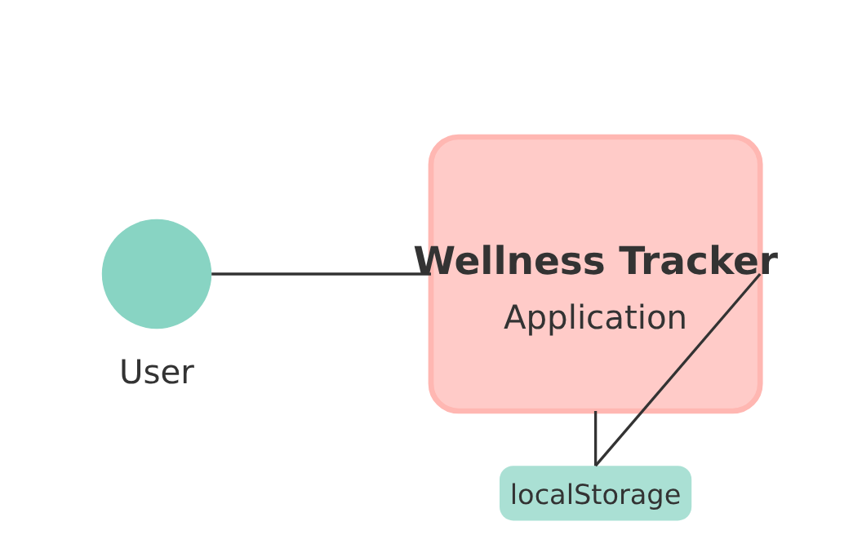
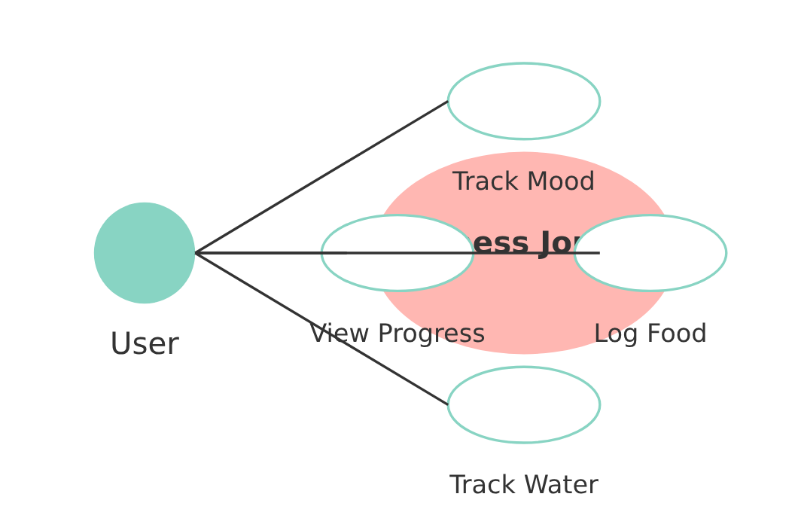
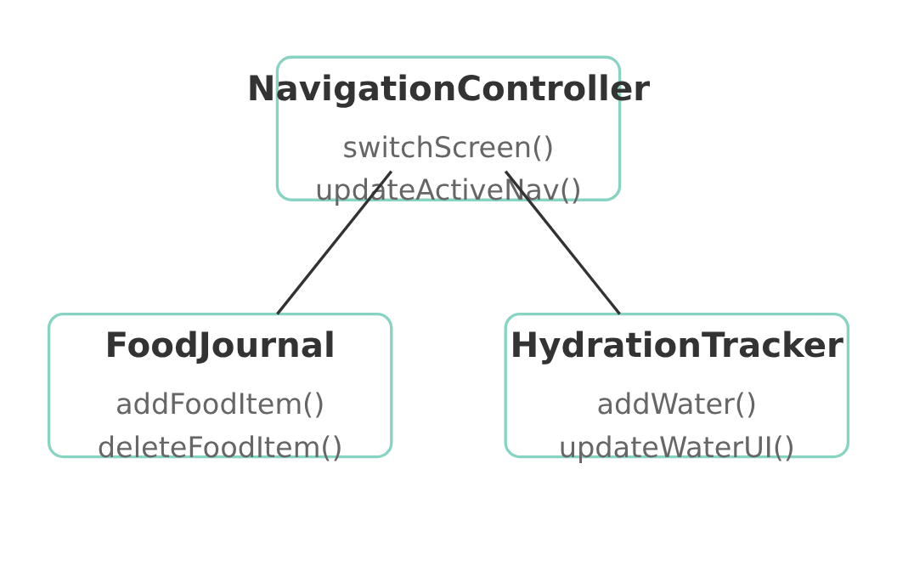




UML Diagrams & Design
Complete software engineering documentation including use case diagrams, class diagrams, and context diagrams showing system interactions and data flow.
Use Case Diagram
Class Diagram
Context Diagram
Visual representation of system features and user interactions
Structure of the application showing classes and relationships
System boundaries and external interactions
External Entity: User
Features: Track Mood, Log Food, Track Water, View Progress
Main Classes: NavigationController, FoodJournal, HydrationTracker
System: Wellness Tracker Application
Includes relationships: User → Features
Relationships: Composition, Association
UML diagrams created with D3.js
Complete documentation available in project resources

Slide 6
























User Interface Design
Neumorphic Design System
Mobile-First Approach
Soft UI design approach with subtle shadows to create a gentle, modern aesthetic that feels both sophisticated and approachable.
Responsive design optimized for mobile devices with adaptive layouts that scale beautifully to larger screens.
Touch-friendly interfaces
Efficient information hierarchy
Soft Mint
Soft Coral
Application Wireframes
Home Screen
Food Journal
Hydration
Journey Stats
Profile/Auth
Mood tracking & quick access
Calorie tracking & history
Water intake tracking
Progress visualization
User management & settings
Color Palette: Soft Mint (#88d4c3) & Soft Coral (#ffb7b2)
Built with HTML5, CSS3, and Vanilla JavaScript

Slide 7























Technology Stack & Implementation
Frontend Technologies
Data Management
Design System
localStorage
Color Palette
HTML5
Client-side data persistence
Soft Mint (#88d4c3), Soft Coral (#ffb7b2)
Semantic markup structure
JSON
Typography
CSS3
Data serialization format
Outfit font family
Neumorphic (Soft UI) design system
UI Style
Vanilla JavaScript
Neumorphic with soft shadows
No framework dependencies
Google Fonts
Outfit font family
Architecture Pattern
Single Page Application
Component-based Structure
Event-driven Interactions
SPA architecture for seamless user experience without page reloads
Responsive UI with interactive elements and state management
Modular components for reusable and maintainable code

Slide 8
















Live Demo & Key Features
Experience the working prototype of The Wellness Journey application, showcasing seamless user experience and core functionalities.
Profile Login
Home Screen
Food Journal
Journey Stats
Smooth Transitions
Form Validation
Real-time Updates
Seamless navigation between screens with animated transitions.
Robust form validation for login, signup, and food entry forms.
Dynamic UI updates as you track food, water intake, and mood.
Data Persistence
Responsive Design
Data saved to localStorage and persists across browser sessions.
Optimized layout that works on mobile, tablet, and desktop.

Slide 9














Future Enhancements & Security
Planned Features
Security Improvements
Backend Integration
Current Implementation
Server-side authentication, cloud data synchronization, multi-device support
Client-side only authentication
Passwords stored in localStorage (not hashed)
Advanced Analytics
No server-side validation
Weekly/monthly reports, trend analysis, goal recommendations
Production Requirements
Social Features
Share progress with friends, community challenges, leaderboards
Server-side authentication with JWT
Password hashing (bcrypt)
Mobile Apps
HTTPS encryption
Native iOS, native Android, Progressive Web App (PWA)
Input sanitization
CSRF protection
Security improvements are critical before deploying to production environments

Slide 10











Project Outcomes & Success
Achievements
Project Success Metrics
All features implemented
Responsive design
Modern web application development with clean architecture
Complete documentation
UML diagrams created
Wireframes developed
Working prototype
User-friendly interface design with neumorphic elements
Learning Outcomes
Comprehensive feature set covering wellness tracking needs
Technical Skills
Engineering Practices
SPA architecture
UML creation
State management
Wireframing
Proper documentation with UML diagrams and wireframes
Form validation
Component design
Neumorphic UI
Code organization
Scalable architecture for future enhancements
Thank You!
Empowering healthier lifestyles through technology

